Slide 1
Chapter 23 – Project planning 项目规划
Lecture 1

Slide 2
Topics covered
Software pricing
Plan-driven development
Project scheduling
Agile planning
Estimation techniques
软件报价
计划驱动的开发
项目进度安排
敏捷规划
估算技术

Slide 3
Project planning 项 目规划
Project planning involves breaking down the work into parts and assign these to project team members, anticipate problems that might arise and prepare tentative solutions to those problems.
The project plan, which is created at the start of a project, is used to communicate how the work will be done to the project team and customers, and to help assess progress on the project.
项目计划被分解成多个部分,并分配个团队成员，必须预见可能出现哪些问题，并且准备好相应的解决办法去应对。
项目计划是在项目开始建立的，是用于向项目开发团队和客户说明工作如何开展，以及帮助估计项目进展的

Slide 4
Planning stages 规划阶段
At the proposal stage, when you are bidding for a contract to develop or provide a software system.
During the project startup phase, when you have to plan who will work on the project, how the project will be broken down into increments, how resources will be allocated across your company, etc.
Periodically throughout the project, when you modify your plan in the light of experience gained and information from monitoring the progress of the work.
在投标提案阶段,为争取一个开发软件系统的开发合同的投标阶段
在项目开始阶段，确定参加此项工作的人员，将工作分解成数个子项目，在公司中如何分配资源等。
贯穿于项目过程中，定期的根据获得的经验和项目紧张的监督信息修改计划

Slide 5
Proposal planning 投标提案计划
Planning may be necessary with only outline software requirements.
The aim of planning at this stage is to provide information that will be used in setting a price for the system to customers.
计划可能是必要的,只有大体的软件需求。
计划在这个阶段的目的是提供信息,将用于设置系统中客户的价格。

Slide 6
23.1 Software pricing 软件报价
Estimates are made to discover the cost, to the developer, of producing a software system.
  You take into account, hardware, software, travel, training and effort costs.
There is not a simple relationship between the development cost and the price charged to the customer.
Broader organisational, economic, political and business considerations influence the price charged.
估计 是 对于开发者来言,是生产一个软件系统 的成本,。
  需要考虑,硬件、软件、旅游、培训和工作成本。
实际上项目成本和向客户提出的价格之间的关系并不总是这么简单
软件报价还需要考虑方方面面的问题，如机构因素、经济和政治因素、商业上的因素等

Slide 7
Factors affecting software pricing
软件定价的影响因素
Factor | Description
Market opportunity 市场机遇 | A development organization may quote a low price because it wishes to move into a new segment of the software market. Accepting a low profit on one project may give the organization the opportunity to make a greater profit later. The experience gained may also help it develop new products.开发组织可能报一个低的价格,因为它想要软件市场的进入一个新的领域。接受一个较低的利润一个项目可能会给组织的机会获得更大的利润。获得的经验也可以帮助开发新产品。
Cost estimate uncertainty成本估算的不确定性 | If an organization is unsure of its cost estimate, it may increase its price by a contingency over and above its normal profit.如果一个组织不确定的成本估计,它可能会为应变增加其价格，超过其正常利润。
Contractual terms 合同条款 | A customer may be willing to allow the developer to retain ownership of the source code and reuse it in other projects. The price charged may then be less than if the software source code is handed over to the customer.顾客可能愿意允许开发人员保留所有权的源代码和重用在其他项目。相比软件源代码是移交给客户，产品的价格可能会低于。

Slide 8
Factors affecting software pricing
Factor | Description
Requirements volatility 需求易变性 | If the requirements are likely to change, an organization may lower its price to win a contract. After the contract is awarded, high prices can be charged for changes to the requirements.如果需求可能会改变,一个组织可能会降低它的价格赢得合同。合同授予后,高价格可以承担需求的更改。
Financial health 财务状况 | Developers in financial difficulty may lower their price to gain a contract. It is better to make a smaller than normal profit or break even than to go out of business. Cash flow is more important than profit in difficult economic times.开发人员在金融困难时，可能会降低他们的价格以获得合同。最好是小于正常利润、或降价而不是倒闭。在经济困难时期，现金流比利润更重要。

Slide 9
23.2 Plan-driven development 计划驱动的开发
Plan-driven or plan-based development is an approach to software engineering where the development process is planned in detail.
  Plan-driven development is based on engineering project management techniques and is the ‘traditional’ way of managing large software development projects.
A project plan is created that records the work to be done, who will do it, the development schedule and the work products.
Managers use the plan to support project decision making and as a way of measuring progress.
计划驱动的开发或基于计划的开发，它是一种给开发过程制定详细计划的软件工程方法。
  计划驱动的开发是基于工程项目管理技术,可以看做管理大型软件开发项目的“传统”方法。
创建项目计划来记录要完成的工作，谁将执行此项工作，开发进度安排以及项目的成果是什么。
管理者使用计划 支持项目决策并将其作为衡量进展的方法。

Slide 10
Plan-driven development – pros and cons
计划驱动的开发——正反两方面
The arguments in favor of a plan-driven approach are that early planning allows organizational issues (availability of staff, other projects, etc.) to be closely taken into account, and that potential problems and dependencies are discovered before the project starts, rather than once the project is underway.
The principal argument against plan-driven development is that many early decisions have to be revised because of changes to the environment in which the software is to be developed and used.
赞成计划驱动的方法 的论点 是早期的计划能很好地考虑机构问题（机构员工等），能够在项目开始前发现潜在的问题和依赖性，而不是等到项目开发时才发现。
反对计划驱动的开发 主要理由是,由于软件开发和使用的环境的变化，必须修改许多早期的决策。

Slide 11
23.2.1 Project plans 项目计划
In a plan-driven development project, a project plan sets out the resources available to the project, the work breakdown and a schedule for carrying out the work.
计划驱动的项目开发中,项目计划包括项目可用的资源、工作分解以及完成工作的进度安排。
Plan sections 计划 部分
  Introduction 引言
  Project organization 项目组织
  Risk analysis 风险分析
  Hardware and software resource requirements 硬件和软件资源需求
  Work breakdown 工作分解
  Project schedule 项目进度安排
  Monitoring and reporting mechanisms 监控和报告机制

Slide 12
Project plan supplements 辅助 项目计划
Plan | Description
Quality plan 质量计划 | Describes the quality procedures and standards that will be used in a project. 描述了项目中所用的质量过程和标准
Validation plan有效性验证计划 | Describes the approach, resources, and schedule used for system validation. 描述的方法、资源和进度用于系统验证
Configuration management plan配置管理计划 | Describes the configuration management procedures and structures to be used. 描述了用于配置管理过程和结构。
Maintenance plan维护计划 | Predicts the maintenance requirements, costs, and effort. 预测维护需求、成本和精力。
Staff development plan 员工发展计划 | Describes how the skills and experience of the project team members will be developed. 描述项目团队成员的技能和经验的发展

Slide 13
23.2.2 The planning process 规划过程
Project planning is an iterative process that starts when you create an initial project plan during the project startup phase.
Plan changes are inevitable.
  As more information about the system and the project team becomes available during the project, you should regularly revise the plan to reflect requirements, schedule and risk changes.
  Changing business goals also leads to changes in project plans. As business goals change, this could affect all projects, which may then have to be re-planned.
  项目规划是一个迭代的过程,在项目的启动阶段初始项目计划的创建就开始了。
  计划的变更是不可避免的。
  由于在项目过程中不断产生新的关于系统和项目团队的信息，所以必须经常性的修正原有的计划。
  业务目标发生改变，会影响到所有的项目，这些项目就必须重新规划。

Slide 14
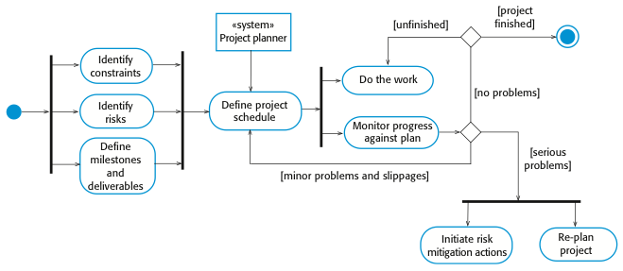
The project planning process 项目规划过程
UML activity diagram - A typical workflow

Slide 15
23.3 Project scheduling 项目进度安排
Project scheduling is the process of deciding how the work in a project will be organized as separate tasks, and when and how these tasks will be executed.
You estimate the calendar time needed to complete each task, the effort required and who will work on the tasks that have been identified.
You also have to estimate the resources needed to complete each task, such as the disk space required on a server, the time required on specialized hardware, such as a simulator, and what the travel budget will be.
项目进度安排是决定如何组织工作，将其分割成单独的一个个人物，并且何时以何种方式完成各项任务的过程。
你需要估算需要勇于完成各个任务的时间、需要的成本以及完成这些既定任务的人员。
你也必须估计完成各项任务所需要的资源，比如服务器上需要的磁盘空间，需要在专门软件上（如仿真器）占中的时间以及项目人员的差旅费预算等。

Slide 16
Project scheduling activities 项目进度活动
Split project into tasks and estimate time and resources required to complete each task.
Organize tasks concurrently to make optimal use of workforce.
Minimize task dependencies to avoid delays caused by one task waiting for another to complete.
Dependent on project managers intuition and experience.
项目分成一个个的任务 和 估计完成每个任务所需的时间和资源。
同时组织任务最优利用劳动力。
最小化任务依赖性,以避免 延误造成的一个任务等待另一个的完成。
依靠项目经理的直觉和经验。

Slide 17
Milestones and deliverables
里程碑和可交付成果
Milestones are points in the schedule against which you can assess progress, for example, the handover of the system for testing.
Deliverables are work products that are delivered to the customer, e.g. a requirements document for the system.
里程碑点的时间表,你可以评估进展,例如,测试的系统交接
可交付成果是工作产品交付给客户,如系统的需求文档。

Slide 18
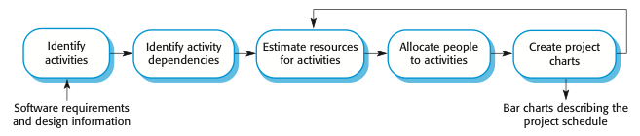
The project scheduling process项目时间安排过程

Slide 19
Scheduling problems 进度安排的问题
Estimating the difficulty of problems and hence the cost of developing a solution is hard.
Productivity is not proportional to the number of people working on a task.
Adding people to a late project makes it later because of communication overheads.
The unexpected always happens. Always allow contingency in planning.
估计问题的难度提高,因此开发一个解决方案 的开发成本是很难的。
生产力是不与工作任务的人数成正比。
加人到延期项目让项目跟延期后,因为通信开销。
想不到的事情总会发生。总是允许应急计划。

Slide 20
Schedule representation 进度安排表示方法
Graphical notations are normally used to illustrate the project schedule.
These show the project breakdown into tasks. Tasks should not be too small. They should take about a week or two.
Bar charts are the most commonly used representation for project schedules. They show the schedule as activities or resources against time.
通常 用图形符号 来说明项目进度。
这些显示,项目分解成任务。任务不应该太小，它们大概需要一两个星期。
条形图是最常用的项目时间表表示法。他们显示了活动的进度或资源。

Slide 21
Tasks, durations, and dependencies
任务、持续时间和依赖关系
Task | Effort (person-days) | Duration (days) | Dependencies
T1 | 15 | 10
T2 | 8 | 15
T3 | 20 | 15 | T1 (M1)
T4 | 5 | 10
T5 | 5 | 10 | T2, T4 (M3)
T6 | 10 | 5 | T1, T2 (M4)
T7 | 25 | 20 | T1 (M1)
T8 | 75 | 25 | T4 (M2)
T9 | 10 | 15 | T3, T6 (M5)
T10 | 20 | 15 | T7, T8 (M6)
T11 | 10 | 10 | T9 (M7)
T12 | 20 | 10 | T10, T11 (M8)

Slide 22
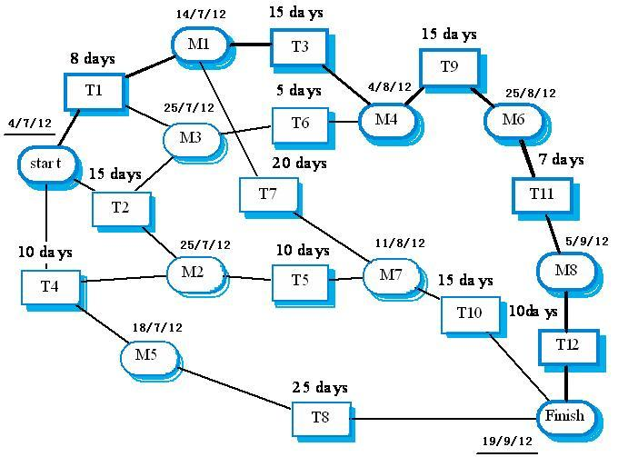
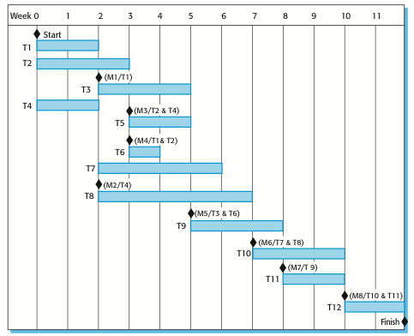
Activity network 活动网络
This activity network is not exactly equivalent to the last slide.

Slide 23
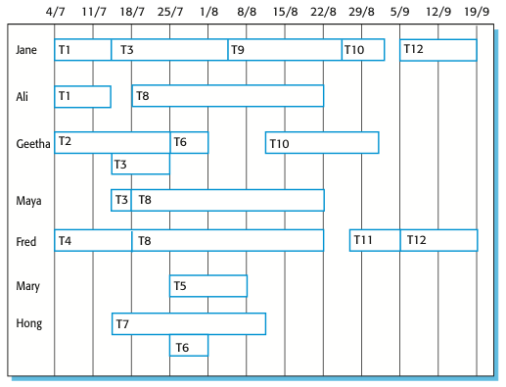
Staff allocation chart 人员分配表
Part-time assignments using a diagonal line crossing the bar

Slide 24
23.4 Agile planning 敏捷规划
Agile methods of software development are iterative approaches where the software is developed and delivered to customers in increments.
Unlike plan-driven approaches, the functionality of these increments is not planned in advance but is decided during the development.
  The decision on what to include in an increment depends on progress and on the customer’s priorities.
The customer’s priorities and requirements change so it makes sense to have a flexible plan that can accommodate these changes.
软件开发中的敏捷方法是一种迭代的方法，软件是以增量式方式进行开发和交付给客户。
与计划驱动的方法不同,这些增量中的功能不是提前计划好的，而是在开发过程中决定的。
——决定增量中包含何种功能取决于进展情况以及客户的需求的优先级。
客户的优先级和需求经常变化,所以制定能适应这些变化的灵活计划是合理的。

Slide 25
Agile planning stages 敏捷规划阶段
(1) Release planning, which looks ahead for several months and decides on the features that should be included in a release of a system.
(2) Iteration planning, which has a shorter term outlook, and focuses on planning the next increment of a system. This is typically 2-4 weeks of work for the team.
(1)版本规划,包括对未来几个月的展望以及决定系统的发布版本中应该包含的功能。
(2)迭代规划，包括短期的展望，主要是规划系统的下一个增量。一般这将花费团队2-4个星期的工作量。

Slide 26
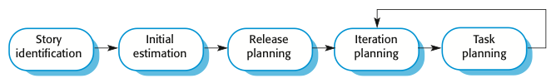
Planning in XP

Slide 27
Story-based planning 基于情节的规划
The system specification in XP is based on user stories that reflect the features that should be included in the system.
The project team read and discuss the stories and rank them in order of the amount of time they think it will take to implement the story.
Release planning involves selecting and refining the stories that will reflect the features to be implemented in a release of a system and the order in which the stories should be implemented.
Stories to be implemented in each iteration are chosen, with the number of stories reflecting the time to deliver an iteration (usually 2 or 3 weeks) and the team’s velocity.
XP中的系统描述是基于用户情节的，用户情节反应了应该包含在系统中的特征。
项目组阅读并且讨论这些情景，然后按照实现这些情景所需要的时间将情景排序
发布规划包括选择和完善上述情景。这些情景反映出了系统的发布版本中应该事先的功能以及实现这些情景的顺序。
选择迭代过程中要实现的情景，情景的个数反映了交付一词迭代的时间（通常2-3周）和项目组的速度

Slide 28
Key points
The price charged for a system does not just depend on its estimated development costs; it may be adjusted depending on the market and organizational priorities.
Plan-driven development is organized around a complete project plan that defines the project activities, the planned effort, the activity schedule and who is responsible for each activity.
Project scheduling involves the creation of graphical representations of part of the project plan. Bar charts show the activity duration and staffing timelines, are the most commonly used schedule representations.
The XP planning game involves the whole team in project planning. The plan is developed incrementally and, if problems arise, it is adjusted so that software functionality is reduced instead of delaying delivery of an increment.
价格收费系统并不仅仅取决于其估计开发成本;它可能是根据市场调整和组织的优先事项。
计划驱动的开发是围绕一个完整的项目计划,定义了项目活动,活动安排和计划工作,负责每个活动。
项目调度涉及到创建的图形化表达项目计划的一部分。条形图显示持续时间和员工的活动时间,是最常用的进度表示。
XP计划策略包括在项目计划中的整个团队。计划是逐步发展的,如果出现问题，应该调整,使软件功能降低，而不是推迟增量交付。（此页未改）

Slide 29
Chapter 23 – Project planning
Lecture 2

Slide 30
23.5 Estimation techniques 估算技术
Organizations need to make software effort and cost estimates. There are two types of technique that can be used to do this:
  Experience-based techniques The estimate of future effort requirements is based on the manager’s experience of past projects and the application domain. Essentially, the manager makes an informed judgment of what the effort requirements are likely to be.
  Algorithmic cost modeling In this approach, a formulaic approach is used to compute the project effort based on estimates of product attributes, such as size, and process characteristics, such as experience of staff involved.
机构需要对软件所需的工作量和成本进行估算，有以下两种估算技术:
基于经验的技术 使用管理者之前的项目和应用领域的经验估算要求的未来工作量，也就是管理者主观给出所需要的工作量的一个估计
算法成本建模 在这种方法中,使用一个公示方法计算项目的工作量，它基于对产品属性（如规模）和过程特点（如参与员工的经验）的估计

Slide 31
Experience-based approaches 基于经验的方法
Experience-based techniques rely on judgments based on experience of past projects and the effort expended in these projects on software development activities.
Typically, you identify the deliverables to be produced in a project and the different software components or systems that are to be developed.
You document these in a spreadsheet, estimate them individually and compute the total effort required.
It usually helps to get a group of people involved in the effort estimation and to ask each member of the group to explain their estimate.
基于经验的技术依赖管理者之前项目的经验以及这些项目中有关软件开发活动的实际工作量投入。
通常,项目管理者需要定义项目中要生成的可交付物以及不同的软件组件或者要开发的系统。
将这些内容记录在电子表格中，单独估算各个子项，再计算出需要的总工作量。
通常召集一组人参与估算工作量，并要求每个组员解释各自的估算结果。
The difficulty with experience-based techniques is that a new software project may not have much in common with previous projects.
基于经验的技术的困难在于意向新软件项目可能和之前的项目没有太多的共同点。

Slide 32
23.5.1 Algorithmic cost modelling·
算法成本模型
Cost is estimated as a mathematical function of product, project and process attributes whose
values are estimated by project managers:
  Effort = A⋅Size^{B}⋅M
  A is an organisation-dependent constant, Size may be either the code size or function/application points, B reflects the disproportionate effort for large projects (usually between 1 and 1.5), and M is a multiplier reflecting product, process and development attributes.
The most commonly used product attribute for cost
estimation is code size(SLOC-the number of lines of source code is the fundamental size metric).
Most models are similar but they use different values for A, B and M.
算法成本建模基于项目的规模、开发的项目类型、其他团队、过程和产品因素，用一个数学公式预测项目的成本
  A是常数因子，Size可以使软件的代码行数或者用功能点或应用点表示的功能的估算,B反映了对于大型项目不成比例的effort(通常1到1.5之间)，M是一个乘数因子，反应了过程、产品、开发属性。
最常用来估算成本的产品属性，是代码量(SLOC-源代码的行数 是 基本尺寸度量)。
大多数模型都是类似的 但他们使用不同的A,B和M的值

Slide 33
Estimation accuracy 估计精度
The size of a software system can only be known accurately when it is finished.
Several factors influence the final size
  Use of COTS and components;
  Programming language;
  Distribution of system.
As the development process progresses then the size estimate becomes more accurate.
The estimates of the factors contributing to B and M are subjective and vary according to the judgment of the estimator.
软件系统的大小只能在完成后才能 准确地知道。
几个因素影响最终的SIZE
  使用COTS组件;
  编程语言;
  系统的分布。
随着开发过程进展，系统的大小被估计的更加准确。
因子B和M的估算往往带有主观色彩，对其估算因人而异。

Slide 34
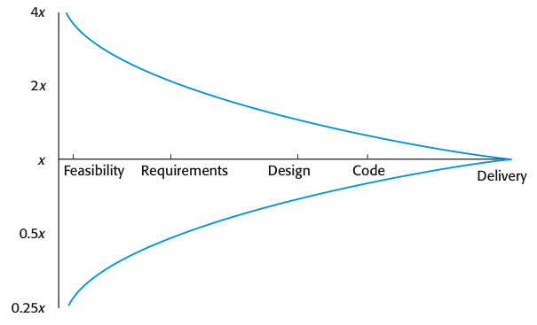
Estimate uncertainty 估计的不确定性
If the initial estimate of effort required is x months of effort, the range of the actual effort as measured when the system was delivered may be from 0.25x to 4x.
假如开始的工作量估计是x个月，那么系统交付时测量的实际工作量可能是0.25x-4x之间
During development planning, estimates become more and more accurate as the project progresses.
在开发计划中，随着项目的进行估算会越来越准确。

Slide 35
23.5.2 The COCOMO 2 model 构造性成本模型
COCOMO(Constructive cost model), an empirical model based on project experience.
构造性的成本模型, 是基于项目经验 的 经验模型。
Well-documented and nonproprietary estimation model which is not tied to a specific software vendor.
Long history from initial version published in 1981 (COCOMO-81) through various instantiations to COCOMO 2.
COCOMO 2 takes into account different approaches to software development, reuse, etc.
良好文档化的和非专利估算模型,和一个特定的软件供应商没有联系。
它有一段历史了。1981年从最初的版本(COCOMO - 81)通过各种实例化到COCOMO 2。
COCOMO 2考虑不同的软件开发方法,重用等。
Modern approaches, such as:
Rapid development using dynamic languages,
Development by component composition,
Use of database programming.
现代的方法,如:
使用动态语言快速开发,
组件组合开发
使用数据库编程。

Slide 36
COCOMO 2 models
COCOMO 2 incorporates a range of sub-models that produce increasingly detailed software estimates.
The sub-models in COCOMO 2 are:
  Application composition model. Used when software is composed from existing parts.
  Early design model. Used when requirements are available but design has not yet started.
  Reuse model. Used to compute the effort of integrating reusable components.
  Post-architecture model. Used once the system architecture has been designed and more information about the system is available.
  COCOMO 2包含了一系列的子模型,产生越来越详细的软件估计。
  COCOMO 2中的模型是:
    应用组合模型。软件从现有的部分组成时使用。
    早期设计模型。需求是可用的,但设计尚未开始时。
    复用模型。用于计算集成可复用的组件的工作量。
    后体系结构模型。当设计出系统的体系结构后，就可以对软件规模做更准确的估算。

Slide 37
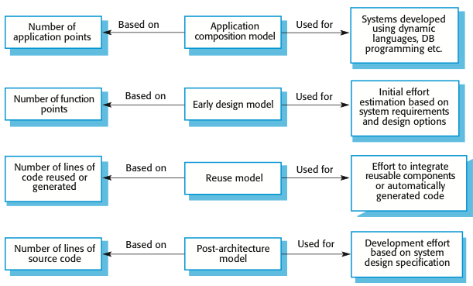
COCOMO estimation models 建设性的成本模型的估测模型

Slide 38
(1) Application composition model应用-组合模型
Supports prototyping projects and projects where there is extensive reuse.适合于原型构造型项目和通过已有组件的组合进行软件开发的项目。
Based on standard estimates of developer productivity in application (object) points/month.
基于加权的应用点（也称对象点） 除以 一个标准应用点生产率
Takes CASE tool use into account.考虑使用CASE工具。
Formula is 公式是
  PM = ( NAP⋅(1 - %reuse/100 ) ) / PROD
  PM is the effort in person-months, NAP is the total number of application points in the delivered system, PROD is the productivity(as shown in next slide) and ‘%reuse’ is an estimate of the amount of reused code in the development.
  PM是以人月为单位的工作量,
  NAP是交付系统中应用程序点的总数
  PROD是应用点生产率(下一个幻灯片所示) 和 “%reuse”是开发中重用代码的估计数量。

Slide 39
Application-point productivity应用程序点效率
Developer’s experience and capability | Very low | Low | Nominal | High | Very high
ICASE maturity and capability | Very low | Low | Nominal | High | Very high
PROD (NAP/month) | 4 | 7 | 13 | 25 | 50
Application composition model produces an approximate estimate as it does not take into account the additional effort involved in reuse.
应用程序组合模型产生的估计只是近似的情况吗，它并未考虑复用中额外工作量。

Slide 40
(2) Early design model 早期设计模型
Estimates can be made after the requirements have been agreed.需求已经确定了，就可以开始这种估计了
Based on a standard formula for algorithmic models
基于一个算法模型的标准公式得出，即
  PM = A⋅Size^{B}⋅M where
  M = PERS⋅RCPX⋅RUSE⋅PDIF⋅PREX⋅FCIL⋅SCED;
  (based on seven project and process attributes-next slide)
  A = 2.94 in initial calibration 校准,
  Size in KSLOC（the number of thousands of lines of source code成千上万行代码的数量）,
  B varies from 1.1 to 1.24 depending on novelty of the project, development flexibility, risk management approaches and the process maturity.指数B反应了随着项目规模的扩大所需工作量的增长，在1.1-1.24之间变动，与项目的创新程度、开发灵活性、采用的风险处理过程、团队凝聚力以及机构的过程成熟度水平密切相关
  This results in an effort computation as follows:
  PM = 2.94⋅Size^{(1.1~1.24)}⋅M

Slide 41
Multipliers 乘数因子M
Multipliers reflect the capability of the developers, the non-functional requirements, the familiarity with the development platform, etc.乘数反映开发人员的能力,非功能性需求,熟悉开发平台等
  RCPX - product reliability and complexity;产品可靠性和复杂性
  RUSE - the reuse required;要求的复用数
  PDIF - platform difficulty;平台困难程度
  PREX - personnel experience;个人能力
  PERS - personnel capability;个人经验
  SCED - required schedule;进度
  FCIL - the team support facilities.支持设施

Slide 42
(3) The reuse model 复用模型
Takes into account black-box code that is reused without change and code that has to be adapted to integrate it with new code.
There are two versions:
  Black-box reuse where code is not modified. The development effort is taken to be zero. Black-box code is code that can be reused without understanding the code or making changes to it.
  White-box reuse where code is modified. A size estimate equivalent to the number of lines of new source code is computed. This then adjusts the size estimate for new code.
  考虑黑盒复用的代码无需更改代码,必须适应与新代码集成。
  有两个版本:
  黑盒重用代码没有修改的地方。开发工作是零。黑盒代码是可以重用的代码,不用理解的代码或修改它。
  白盒重用的代码被修改。大小估计相当于新源代码的行数的计算。然后调整新代码大小的估计。

Slide 43
Reuse model estimates 1 复用模型评估1
For generated code:生成代码
  PM = (ASLOC * AT/100)/ATPROD
  ASLOC is the number of lines of reused/generated code
    重用/生成代码的总行数
  AT is the percentage of code automatically generated.
    自动生成的复用代码的所占百分比
  ATPROD is the productivity of engineers in integrating this code.
    工程师在集成这些代码时的生产率
Boehm, et al.(2000) have measured ATPROD to be about 2,400 source statements per month. Therefore, if there are a total of 20,000 lines of reused source code in a system and 30% of this is automatically generated, then the effort required to integrate the generated code is:
Boehm等人（2000）估计ATPROD 为每月2400条源码语句，因此，如果系统中有20000行复用代码，切其中30%是自动生成的，则整合这些生成代码的工作量为:
(20000 * 30/100)/2400=2.5 person-months //generated code例子

Slide 44
Reuse model estimates 2 复用模型评估2
The following formula is used to calculate the number of equivalent lines of source code:
  ESLOC = ASLOC * AAM.
  ESLOC is the equivalent number of lines of new source code.
  ASLOC is the number of lines of code in the components that have to be changed.
  AAM is an Adaptation Adjustment Multiplier, it adjusts the estimate to reflect the additional effort required to reuse code. Simplistically, AAM is the sum of three components:
    An adaptation component(referred to as AAF) that represents the costs of making changes to the reused code.
    An understanding component(referred to as SU) that represents the costs of understanding the code to be reused and the familiarity of the engineer with the code.
    An assessment factor(referred to as AA) that represents the costs of reuse decision making. AA varies from 0 to 8 depending on the amount of analysis effort required.

Slide 45
Reuse model estimates 2 复用模型评估2
下面的公式计算等价的源代码行数
  ESLOC = ASLOC * AAM.
  ESLOC 是新源代码的相当行数.
  ASLOC 是必须修改的组件的代码行数.
  AAM 改写调整因子，它的调整估计以反映复用代码额外需要的工作量，简单来说，AAM是3个部分的和:
    改写部分（AAF），表示修改这些复用代码的成本，包括设计、编码和集成等修改 等几个字部分.
    理解部分（SU），表示理解要复用的代码以及工程师熟悉这些代码所需的代价，其范围时50-10,50表示复杂的非结构化代码，10表示书写良好的面向对象的代码.
    评估因子（AA），表示复用的决策成本。AA包括决定代码是否能复用的必要的一些分析代价。根据所需的分析两的不同AA的值从0变化到8.

Slide 46
Reuse model estimates 2 复用模型评估2
If some code adaptation can be done automatically, this reduces the effort required. You therefore adjust the estimate by estimating the percentage of automatically adapted code(AT) and using this to adjust ASLOC. Then the final formula is:如果能自动完成一些代码的改写，将减少需要的工作量，因此通过估计自动调整的代码（AT）的白分比调整估算，并使用AT调整ASLOC。因此最终公式为:
  ESLOC = ASLOC * (1-AT/100) * AAM.
  Once ESLOC has been calculated, you then apply the standard estimation formula to calculate the total effort required, where the Size parameter equals to ESLOC. You then add this to the effort to integrate automatically generated code that you have already computed, thus computing the total effort required.
  一旦计算出ESLOC的值，就可以应用标准估算公式计算总工作量，规模参数等于ESLOC。接下来将这加到计算完的集成自动产生代码的工作量，就可以计算出需要的总工作量。

Slide 47
(4) Post-architecture level 后体系结构层
Uses the same formula as the early design model but with 17 rather than 7 associated multipliers.其基本公式与早期设计估算中的基本公式相同,大米有17个乘数因子而不是7个。 PM = A⋅Size^{B}⋅M
The code size is estimated as:估算代码规模需要下面3个参数
  (1) Number of lines of new code to be developed(SLOC);
  (2) Estimate of equivalent number of lines of new code computed using the reuse model(ESLOC);
  (3) An estimate of the number of lines of code that have to be modified according to requirements changes.
  (1)要开发新代码的行数估计(SLOC);
  (2)基于用复用模型计算得到的代价代码行数 (ESLOC)的复用成本的估计;
  (3)由于需求变更可能要修改的代码行数的估计。
  We add the values of these parameters to compute the total code size, in KSLOC, that you use in the effort computation formula.
  我们添加了这些参数的值来来计算总代码大小,总的代码规模ESLOC，用在计算工作量的公式中。

Slide 48
The exponent term 计算B时的级别因素
通过以下的5个因子来计算指数B的值，这些因子都有0-5六个等级，0表示“非常高”，5表示“非常低”，计算B时，将这些值相加再除以100然后再加上1.01就是该数值的取值了。（B=sum/100+1.01).
Scale factor | Explanation
Precedentedness有先例可以援引 | Reflects the previous experience of the organization with this type of project. Very low means no previous experience; extra-high means that the organization is completely familiar with this application domain.
Development flexibility开发灵活性，数低意味着使用规定的过程;高意味着客户端设置只能进行一般的目标。 | Reflects the degree of flexibility in the development process. Very low means a prescribed process is used; extra-high means that the client sets only general goals.
Architecture/risk resolution体系结构/风险解决方案 | Reflects the extent of risk analysis carried out. Very low means little analysis; extra-high means a complete and thorough risk analysis.
Team cohesion团队凝聚力 数高意味着一个完整和全面的风险分析 | Reflects how well the development team knows each other and work together. Very low means very difficult interactions; extra-high means an integrated and effective team with no communication problems.
Process maturity过程成熟度 数非常低意味着非常困难的交互 | Reflects the process maturity of the organization. The computation of this value depends on the CMM Maturity Questionnaire, but an estimate can be achieved by subtracting the CMM process maturity level from 5.
Scalefactors used in the exponent computation in the post-architecture model

Slide 49
The exponent term 计算B时的级别因素
Example:
A company takes on a project in a new domain. The client has not defined the process to be used and has not allowed time for risk analysis. The company has a CMM level 2 rating.
一个公司在一个新的领域开发一个项目。客户端没有定义要使用的方法 和 时间不允许做风险分析。公司拥有一支CMM二级评级。
  Precedenteness - new project (4) 取值为“低” 新项目>(4)
  Development flexibility - no client involvement - Very high (1)
  取值为“非常高” 开发过程中没客户接入，几乎不存在外部强加的改变>(1)
  Architecture/risk resolution - No risk analysis - V. Low .(5)
  取值为“非常低” 没有风险分析>(5)
  Team cohesion - new team - nominal (3)取值为“一般” 新团队 没相关信息>(3)
  Process maturity - some control - nominal (3)取值为“一般”有一些过程控制>(3)
Scale factor is therefore 1.17, which is calculated by:
规模因子计算:B=(4+1+5+3+3)/100+1.01=1.17

Slide 50
Multipliers 乘数因子M
Product attributes
  Concerned with required characteristics of the software product being developed.
Computer attributes
  Constraints imposed on the software by the hardware platform.
Personnel attributes
  Multipliers that take the experience and capabilities of the people working on the project into account.
Project attributes
  Concerned with the particular characteristics of the software development project.
产品属性——关心需要开发软件产品的特性。
电脑的属性——限制在软件的硬件平台上。
人员属性——乘数的经验和能力,在项目工作的人。
项目属性——关注特定的软件开发项目的特性。

Slide 51
The effect of cost drivers on effort estimates
估算成本动因的影响
指数的值 | Exponent value | 1.17
系统规模（包括复用和需求易变性的因素） | System size (including factors for reuse and requirements volatility) | 128,000 DSI
不计成本形成因素的初始COCOMO估计 | Initial COCOMO estimate without cost drivers | 730 person-months
可靠性 | Reliability | Very high, multiplier = 1.39 | Assign maximum values to the key cost drivers
复杂性 | Complexity | Very high, multiplier = 1.3
内存限制 | Memory constraint | High, multiplier = 1.21
使用工具 | Tool use | Low, multiplier = 1.12
进度 | Schedule | Accelerated, multiplier = 1.29
调整的COCOMO估计 | Adjusted COCOMO estimate | 2,306 person-months

Slide 52
The effect of cost drivers on effort estimates
Exponent value | 1.17
Reliability可靠性 | Very low, multiplier = 0.75 | Assign minimum values to the key cost drivers
Complexity复杂性 | Very low, multiplier = 0.75
Memory constraint内存限制 | None, multiplier = 1
Tool use工具使用 | Very high, multiplier = 0.72
Schedule进度 | Normal, multiplier = 1
Adjusted COCOMO estimate调整的估计 | 295 person-months
We can see that high values for the cost drivers lead an effort estimate that is more than three times(2306) the initial estimate(730), whereas low values reduce the estimate to about one-third(295) of the original.
This highlights the significant differences between different types of projects and the difficulties of transferring experience from one application domain to another.我们可以看到,对成本形成因素取较高值是的工作量估算(2306)，是初始估计(730)的三倍以上,而对这些成本形成因素去低值时的工作量会降低到初始估算的1/3（295）。
这样就突出表示了不同类型项目之间的巨大差异，以及在将一个领域的经验移植到另一个领域的巨大困难。

Slide 53
23.5.3 Project duration and staffing
项目的工期和人员配备
As well as effort estimation, managers must estimate the calendar time required to complete a project and when staff will be required.项目管理者除了要对软件系统开发所需成本及其工作量作出估算外，还必须估算软件的开发周期以及人员要在什么时间到位。
Calendar time can be estimated using a COCOMO 2 formula COCOMO 2模型包括一个队项目所需日历时间的计算公式
  TDEV = 3 ⋅ (PM)^{(0.33+0.2*(B-1.01))}
  PM 是COCOMO计算出来的工作量
  B 是之前讨论的复杂度相关的指数
  TDEV是项目的理论进度（月），忽略关于项目进度的任何乘数.
The time required is independent of the number of people working on the project.

Slide 54
Staffing requirements 员工要求
Staff required can’t simply be computed through dividing the total effort by the required project schedule.
The number of people working on a project varies depending on the phase of the project.
The more people who work on the project, the more total effort is usually required.
A very rapid build-up of people often correlates with schedule slippage.
员工要求不能简单地通过划分总体工作量计算所需的项目进度。
工作在一个项目的人数要取决于项目的阶段。
对项目工作的人越多,越需要总工作量。
快速组建的人们，经常进度的下降。（本页没改）

Slide 55
Key points
Estimation techniques for software may be experience-based, where managers judge the effort required, or algorithmic, where the effort required is computed from other estimated project parameters.
The COCOMO II costing model is an algorithmic cost model that uses project, product, hardware and personnel attributes as well as product size and complexity attributes to derive a cost estimate.
给软件评估技术可能是基于经验,经理判断所需的工作量,或从其他项目参数估计中算哪里需要工作量。
COCOMO II成本模型是一个算法模型,使用成本项目、产品、硬件、人员属性、产品属性、产品大小、复杂属性获得成本估计（本页没改）

